Slide 1

SQL Operations Studio: One year later…
Luca Bruni

Slide 2



Organizers
GetLatestVersion.it

Slide 3






Sponsors

Slide 4


About me
~15 years in IT
Full-stack Senior Software Developer Consultant
UGISS Contributor
User Group Italiano SQL Server (PASS Chapter)
Speaker?
Level 2 starting!
eMail: mrg3d@hotmail.com
twitter: @mrg3d
linkedIn: https://www.linkedin.com/in/mrg3d/

Slide 5
Once upon a time…

Slide 6

… there was a tool named…
SQL Operations Studio

Slide 7
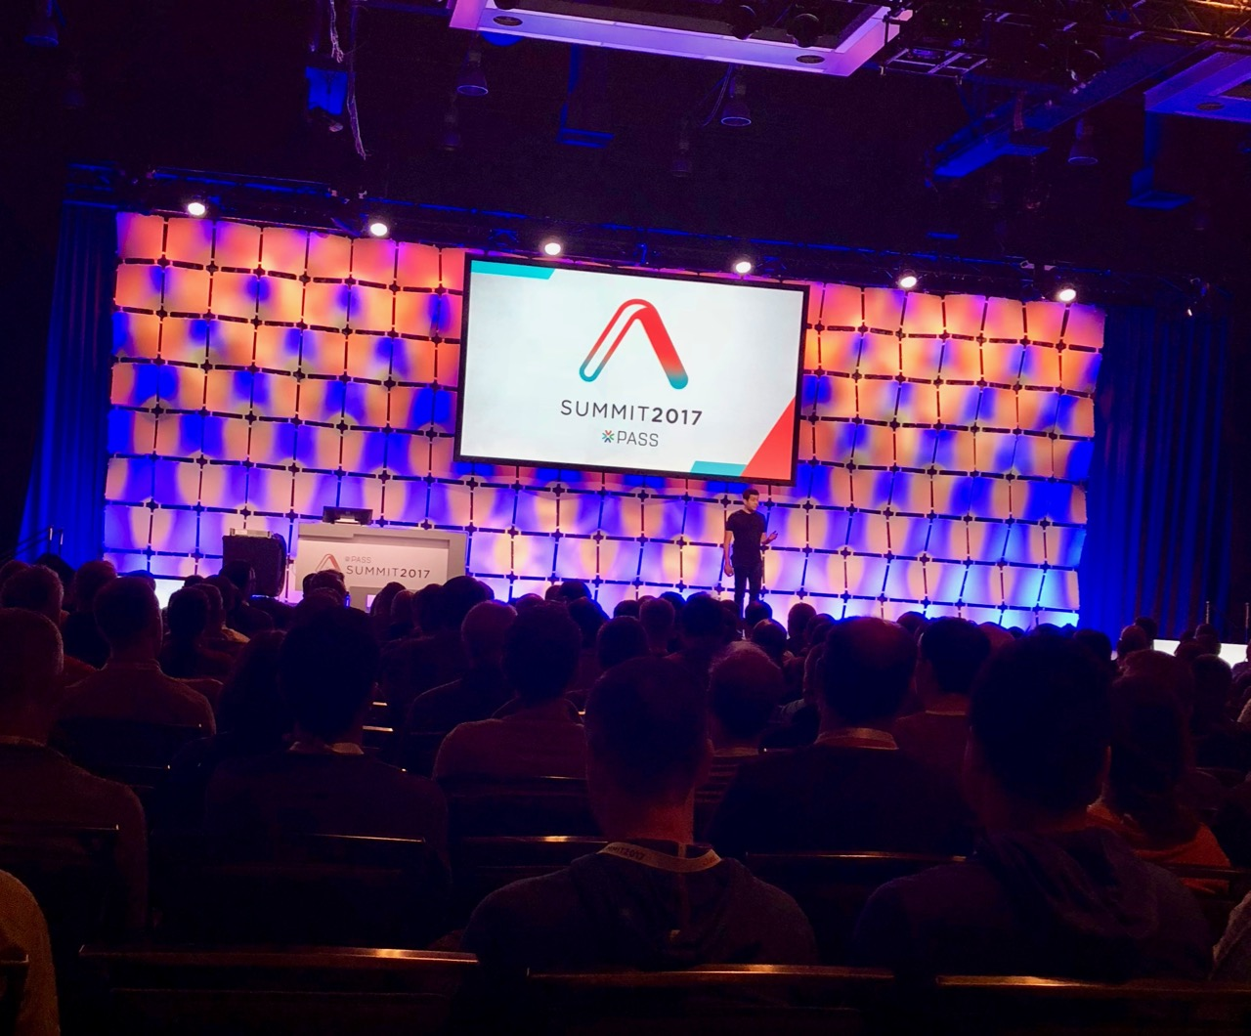
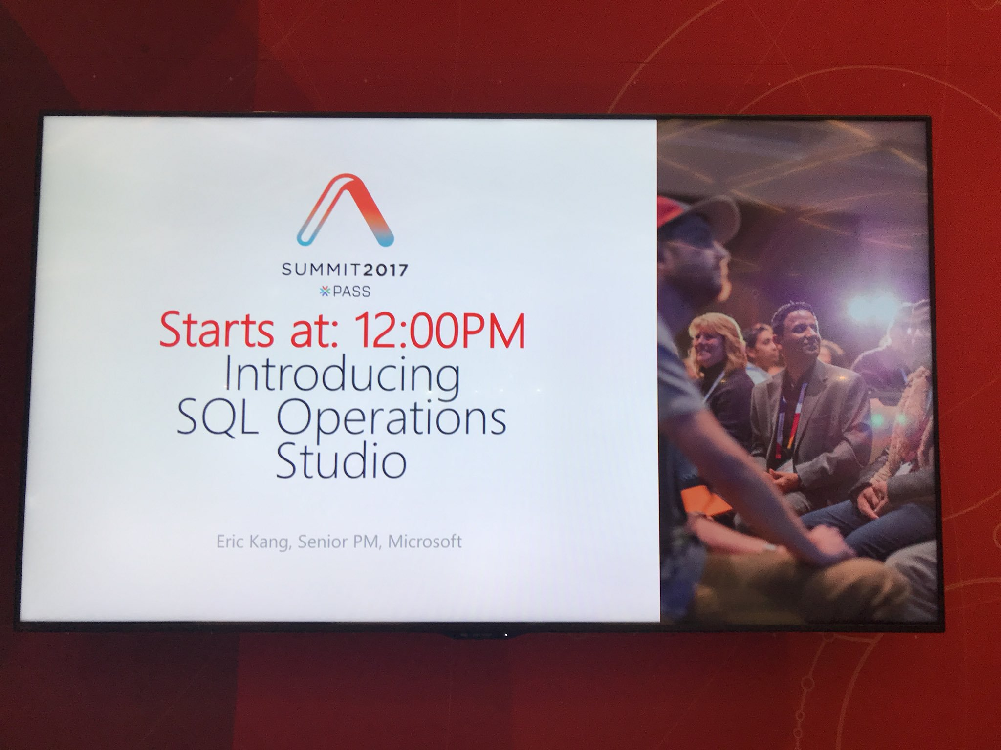
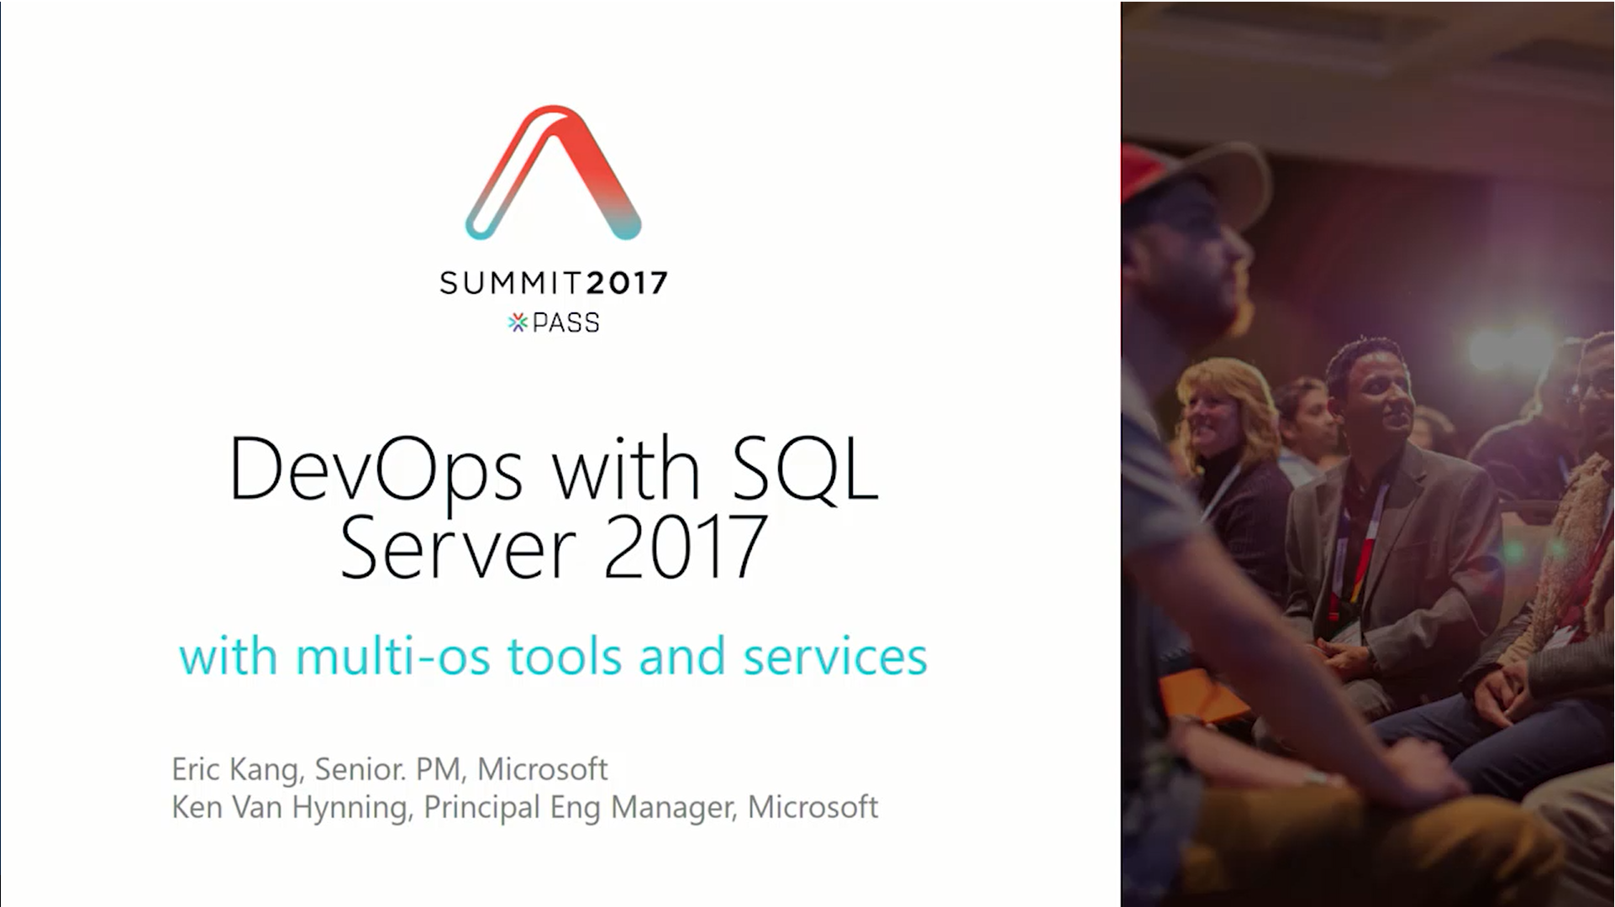
The Origin

Slide 8
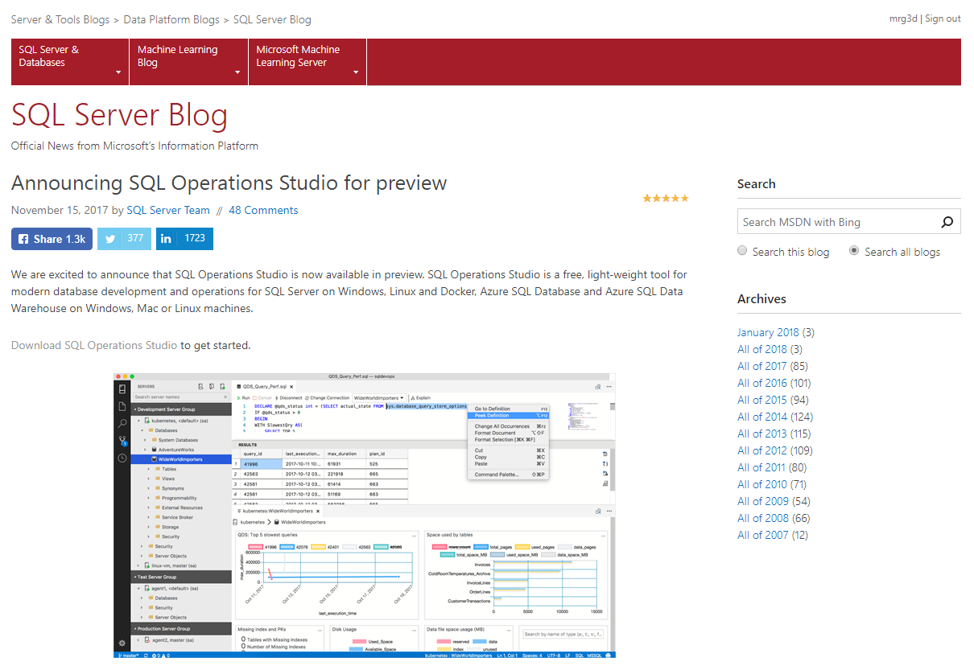
The Birth date

Slide 9
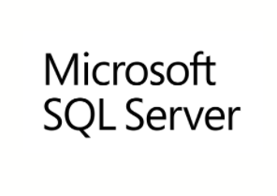
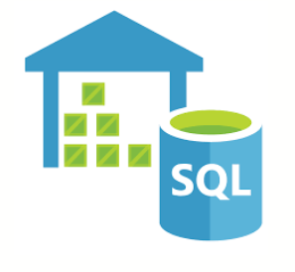


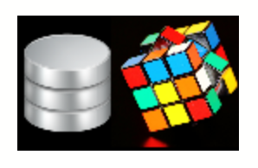



… it was growing up very fast

Slide 10
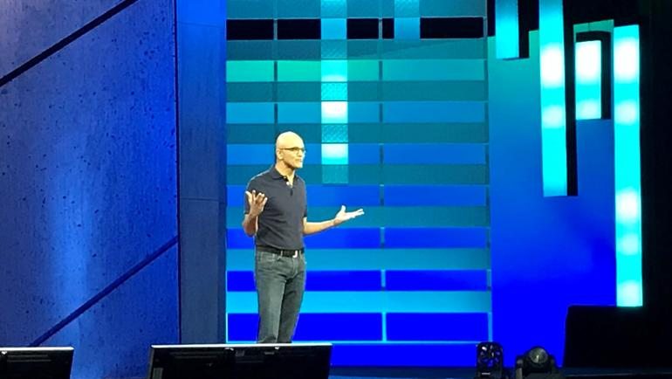
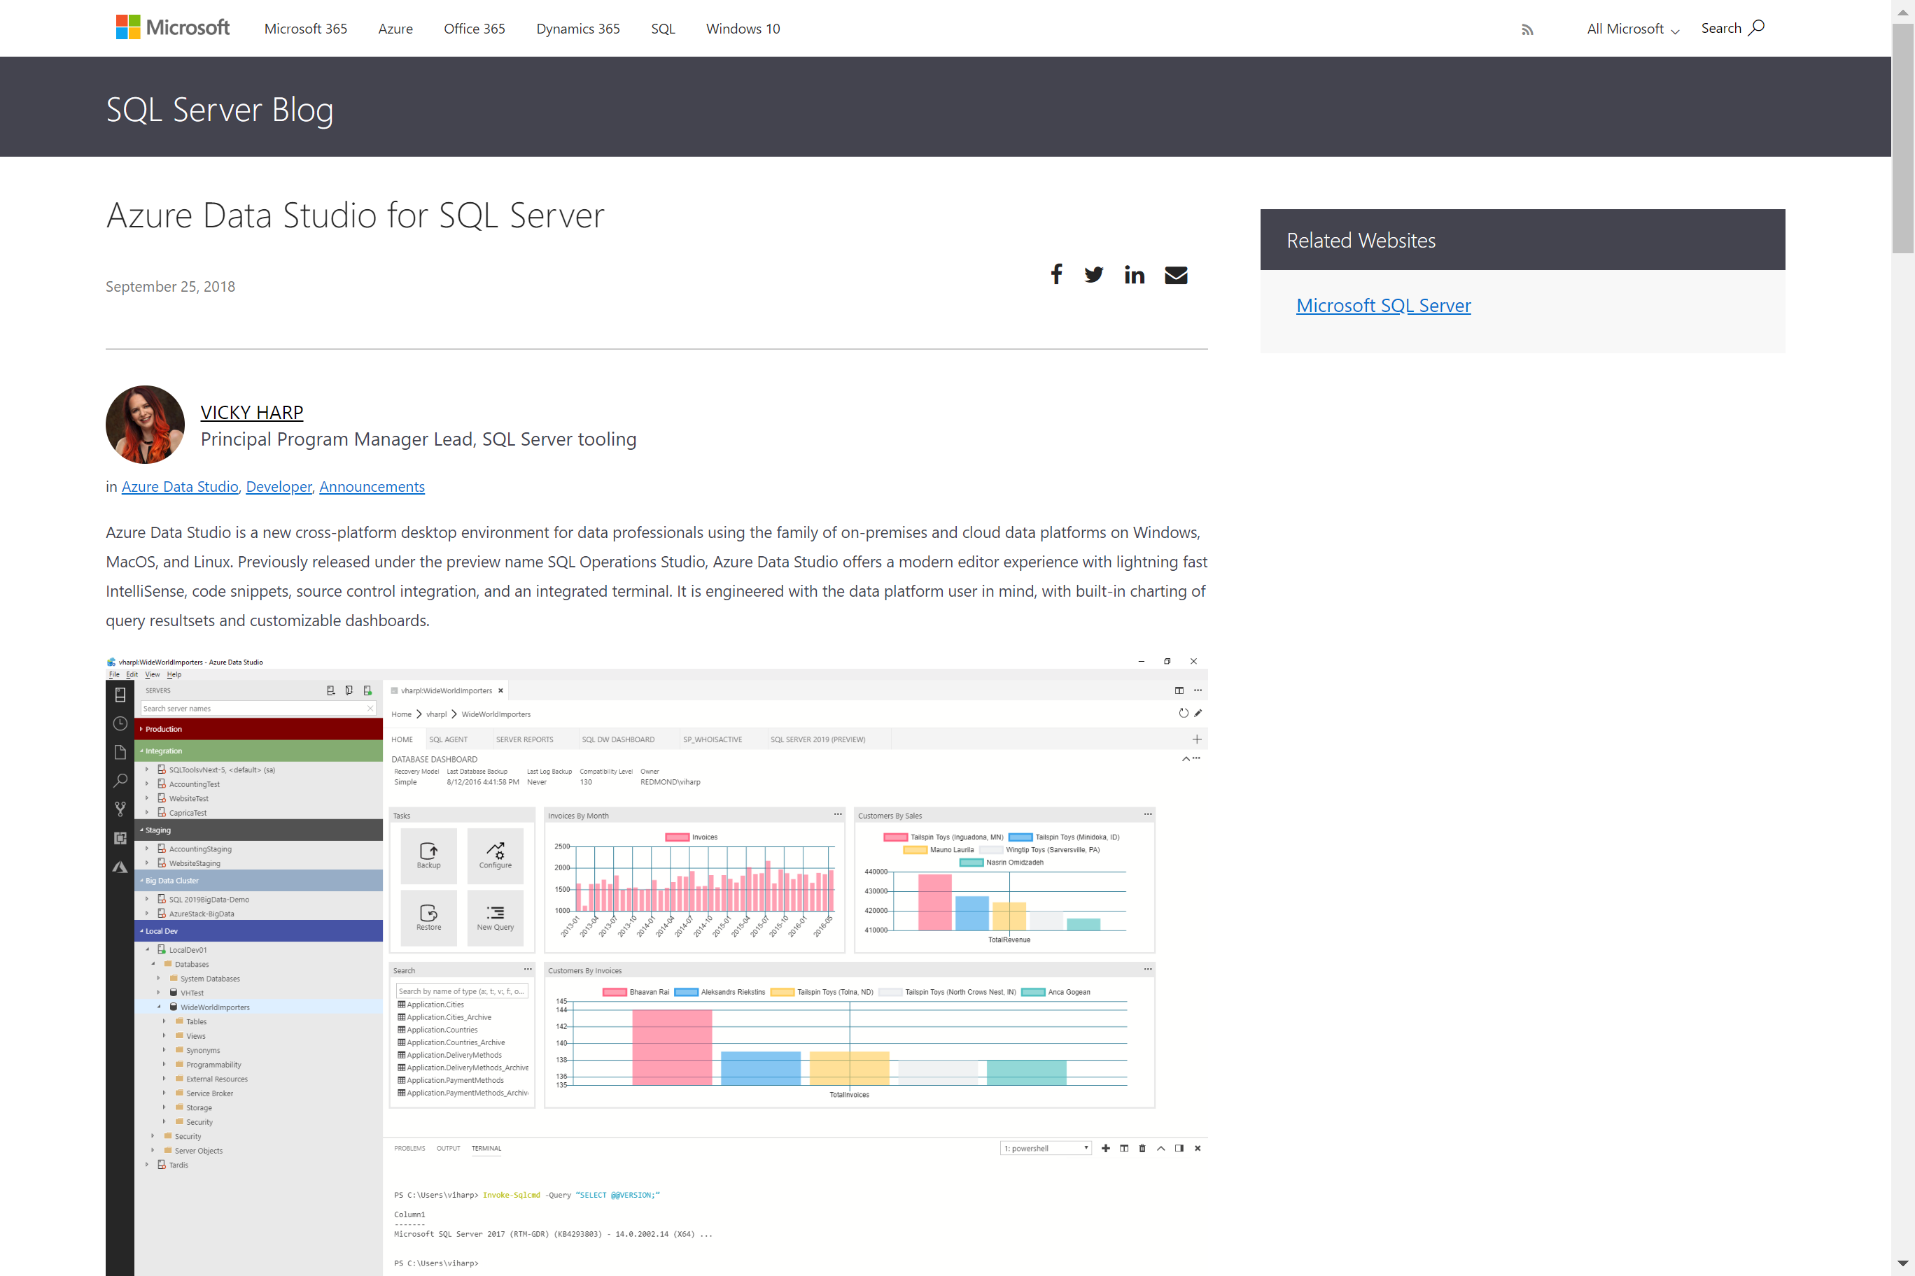
But, during Microsoft Ignite…
Something is going to happen..

Slide 11

Azure Data Studio
General Available

Slide 12
Ok… This is the story!

Slide 13
Agenda
Why, What, Who and How?
Tool overview
Main Extensions Overview
What’s next?

Slide 14

Why & What
Light Weight
Extensible
Free
For Windows,
macOS and Linux
~
~
For SQL Server running anywhere, Azure SQLDB & DW
Introducing SQL Operations Studio – Eric Kang
https://channel9.msdn.com/Events/Connect/2017/T255/player

Slide 15
Who’s it for
For Database Dev
For Ops
Empowers DevOps practice
Introducing SQL Operations Studio – Eric Kang
https://channel9.msdn.com/Events/Connect/2017/T255/player

Slide 16
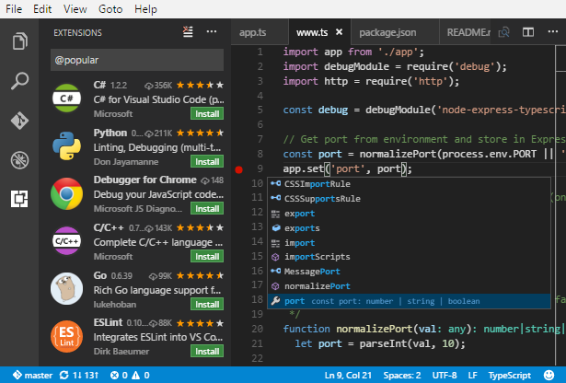

How
Spin-off from Visual Studio Code
Open source project

Slide 17
How to contribute

Slide 18
How to contribute
Pull requests
Feedback & Suggestions
Localization
Extensions

Slide 19
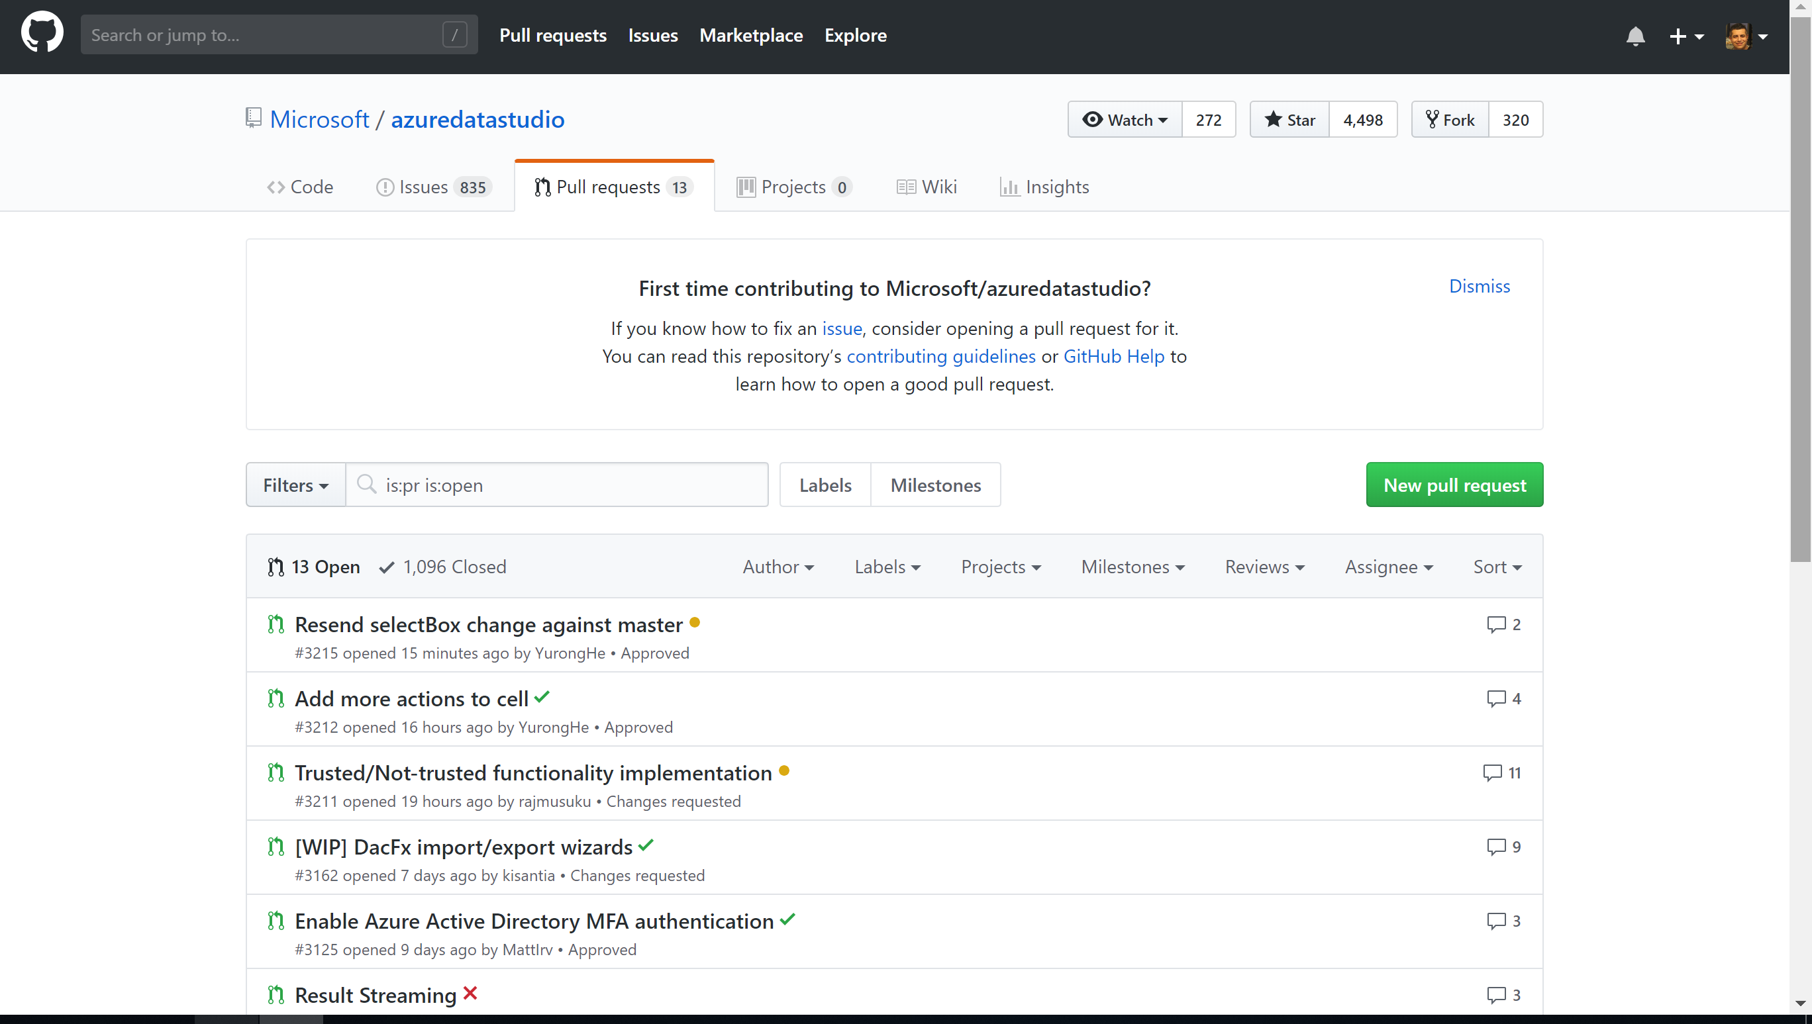



Pull Requests
Electron Shell using Python on Node.js
https://github.com/Microsoft/azuredatastudio

Slide 20
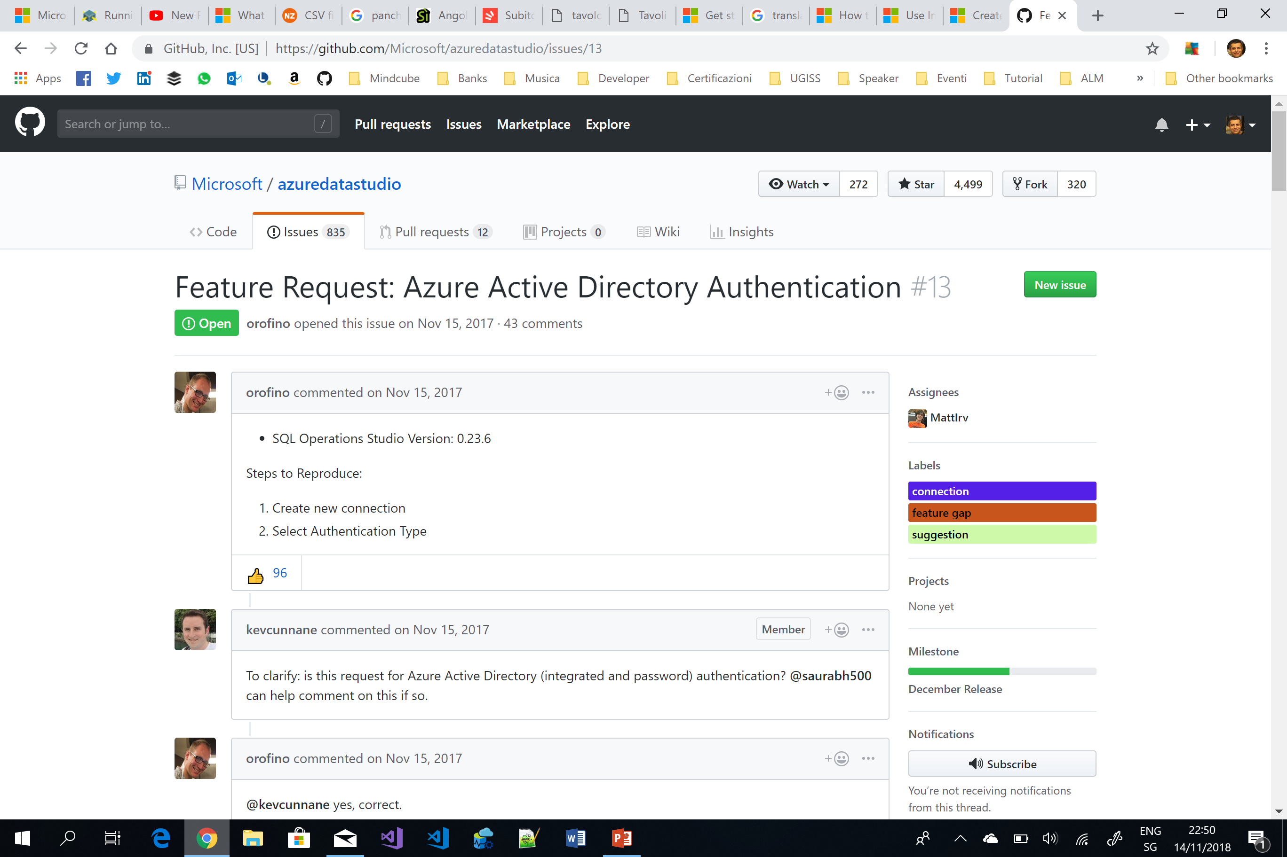
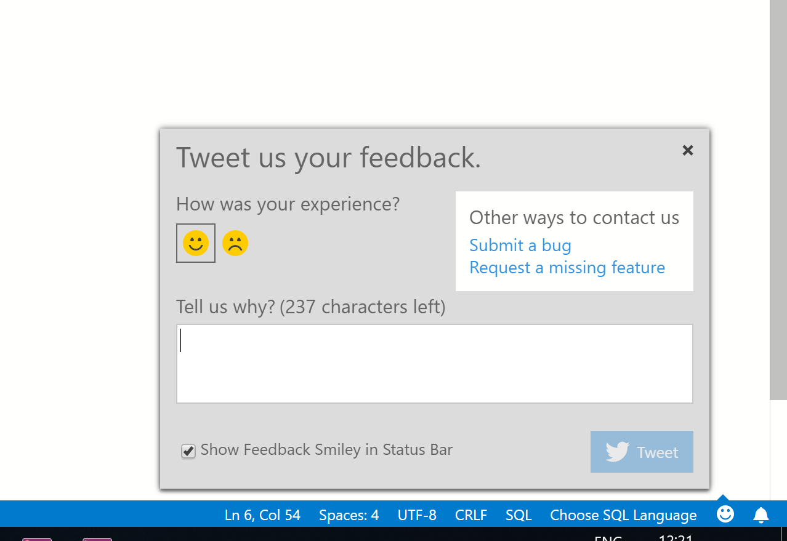
Feedback & Suggestions

Slide 21
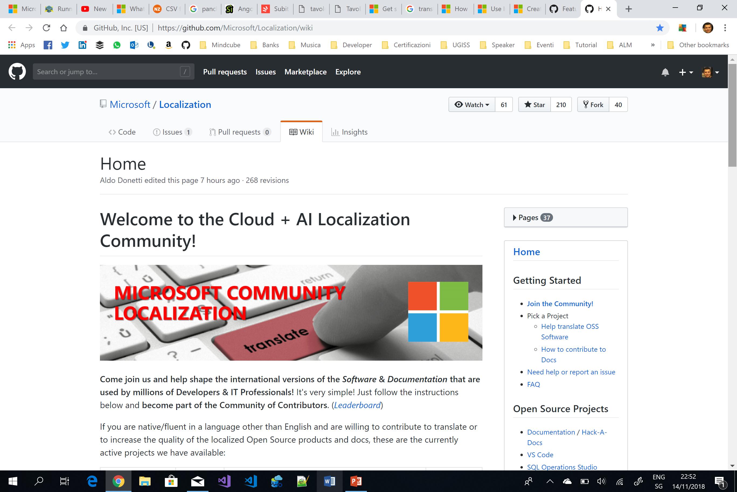
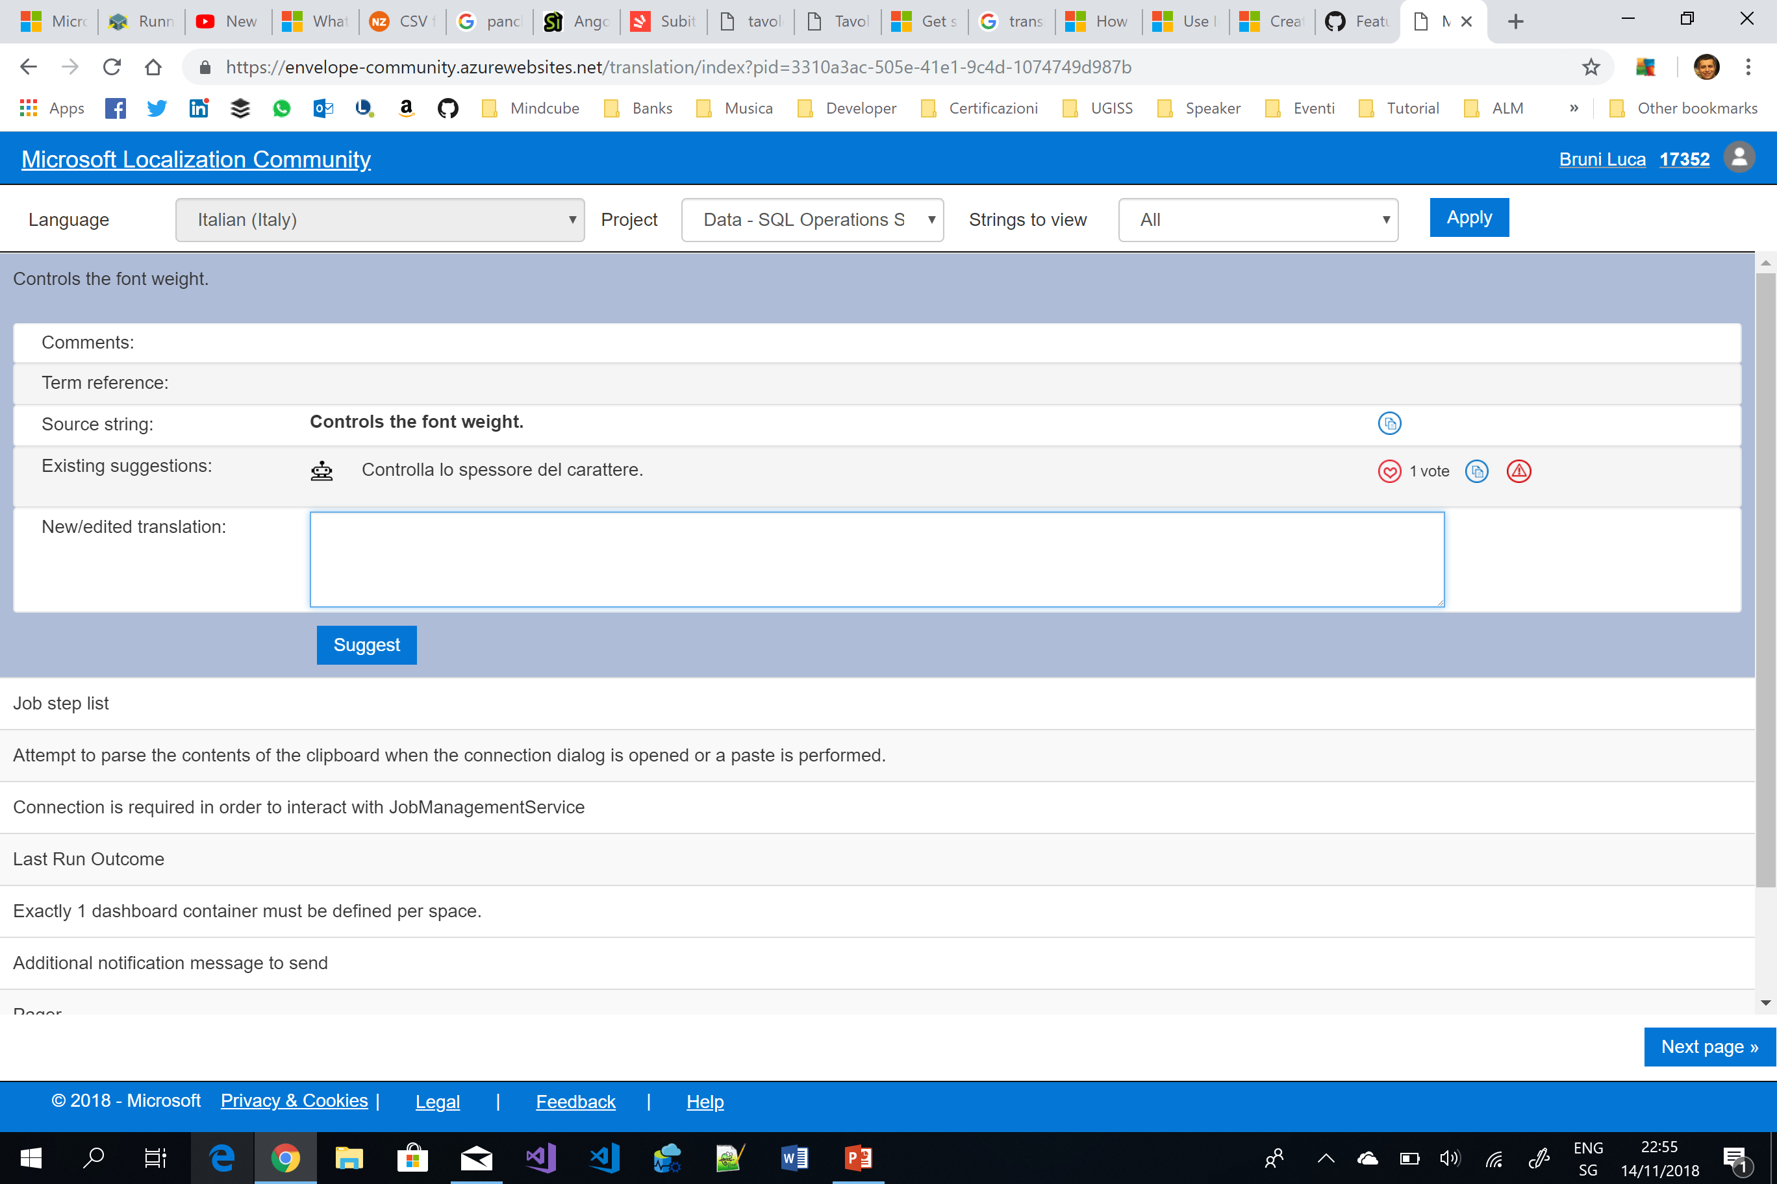
Localization
Cloud + AI Localization Community
https://github.com/Microsoft/Localization/wiki

Slide 22
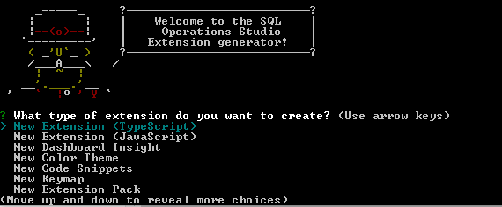
Building Extensions
Node.js
Yeoman extension generator
https://www.npmjs.com/package/generator-sqlops
Create package using «vsce» utils
Publish

Slide 23
Functions & features

Slide 24
Core functionalities
Connect to SQL Server
Explore server and database objects
Advanced T-SQL code editor with IntelliSense
Execute queries and view results

Slide 25

Peculiarities
Code snippets
Integrated terminal
User and Workspace settings
Server and Database Dashboards
Source control
Extensibility
Azure Resource Explorer

Slide 26
DEMO

Slide 27
Code snippets
Templates that make easy database and server objects creation
Built-in snippets T-SQL
User-defined snippets
Typing the keyword sql in the query editor

Slide 28
Integrated Terminal
Multiple terminal
Support for any shell
Bash, PowerShell, sqlcmd, bcp, psql, ssh, etc…
MUST support stdin/stdout/stderr redirection
Configurable
Terminal Display Settings
Terminal Key Bindings

Slide 29
User and Workspace settings
Tool is easy to configure through settings:
Editor, user interface, and functional behavior
Two different scopes
User
Workspace
Workspace = a folder on your computer

Slide 30
Dashboard & Insight widgets
Dashboard
Server & Database Dashboard
Dashboard structure saved in Settings
Widgets
Customizable charts and graphs
Servers and database insights at-a-glance
Drill-down into more details
Take remediations with Insight Action

Slide 31
Source Control
Git Source Control Manager (SMC)
Requires Git (>2.0.0)
Inherited from VS Code
No other SCM provider (at the moment)

Slide 32
Extensibility
Extensible by Design
Several extensibility mechanisms
Visual Studio Code extensibility APIs
Azure Data Studio extension authoring tools
Manage Dashboard tab panel contributions
Insight with Actions experiences
Azure Data Studio extensibility APIs
Custom Data Provider APIs
Extension Authoring
MarketPlace

Slide 33
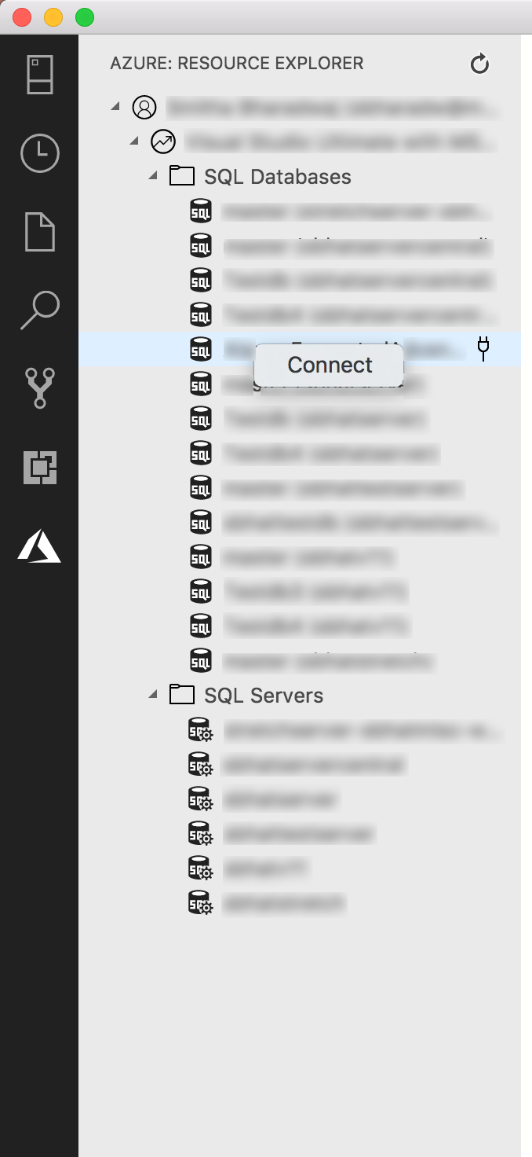
Azure Resource Explorer
Navigate through Azure resources
Multiple accounts
Supports
Azure SQL Server
Azure SQL Database
Azure SQL Managed
…

Slide 34
Extensions

Slide 35
SQL Server Agent extension
Manage and Troubleshoot SQL Agent jobs
Key actions
List SQL Server Agent Jobs
View Job History
Basic Job Control

Slide 36
SQL Server Import extension
Converts text files into SQL tables
Based on PROSE (PROgram Synthesis using Examples)
Text transformation by examples
Data extraction from text files
Data extraction and transformation of JSON
Predictive file splitting

Slide 37
SQL Server Profiler extension
Tracing solution similar to SSMS
Based on XEvents
Event browser
Default values for common tracing use-cases

Slide 38
SQL Server 2019 extension
Preview support for SQL Server 2019 new features and tools
Big Data Clusters
Integrated Notebooks
Polybase Create External Table wizard
Azure Resource Explorer

Slide 39
SQL Server 2019 Big Data Clusters
A cluster of Linux Containers orchestrated by Kubernetes
Deploy of scalable clusters of SQL Server, Spark and HDFS containers
SQL Server 2019 extension provides:
Built-in snippets for common management tasks.
Ability to browse HDFS, upload files, preview files, and create directories.
Ability to create, open, and run Jupyter-compatible notebooks.
Data virtualization wizard to simplify the creation of external data sources.

Slide 40
Big Data Cluster Notebooks
Notebooks are places where Data Scientists can do
Data Ingestion
Data Discovery
Data Analytics
Data Visualization & Collaboration
SQL Server 2019 extension allows
Launch notebooks
Start authoring your ones
Submit jobs against the cluster

Slide 41
Polybase Create External Table wizard
SQL Server 2019 enables data virtualization
Minimization of ETL processes
Polybase connectors
Create External Table wizard enables the data virtualization process

Slide 42
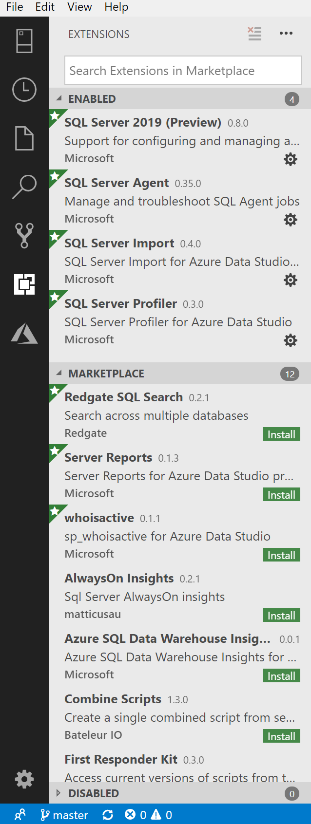
… and many other interesting extensions
AlwaysOn Insight
Azure SQL Datawarehouse Insights
Combine scripts
First Responder Kit
HCQ (High Colour Queries)
MSSQL Db insights
MSSQL Instance Insights
Paste the Plan
Redgate SQL Search
Server Report
SSMS Keymap
whoisactive

Slide 43
What’s coming next?

Slide 44
Exploring the project Backlog
December Release
Improvements in SQL Server 2019 support
AAD Authentication
Integration with Azure Pipelines
…
January Release
Improvements in Query Editor
Linked Servers
Deepin 15.7 (Debian distro) support
…
February Release
Actual Execution Plans
…
SQL Server 2019 Extension
Lots of things!!!

Slide 45
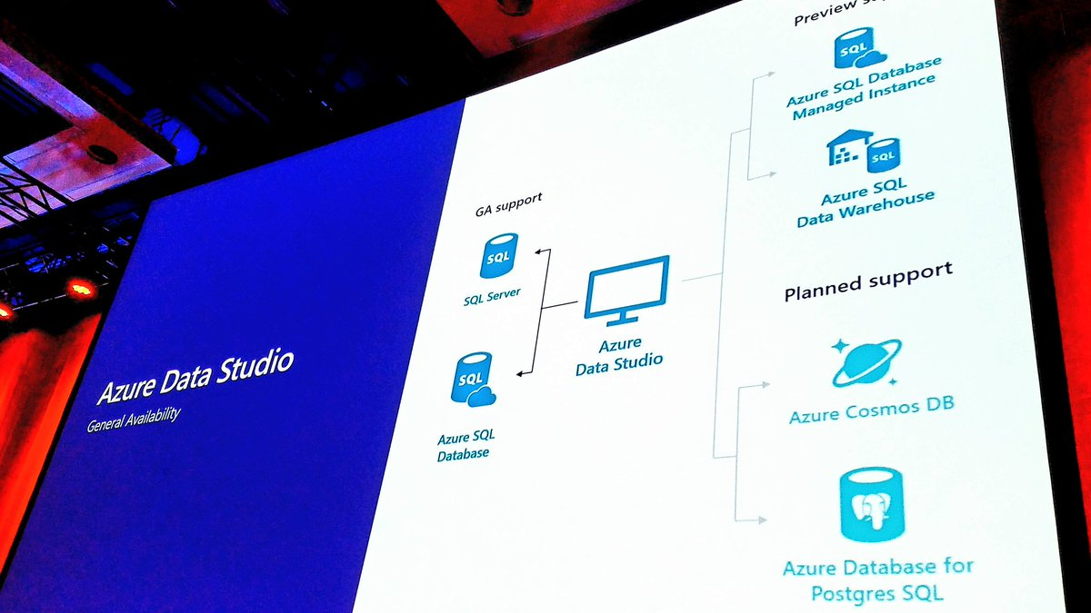
News from PASS Summit 2018
Azure SQL Database Managed Instance and Azure SQL Data Warehouse
Support Azure Cosmos DB
Support Azure Database for Postgres SQL

Slide 46
What’s in the pot?
Continue filling gap in SSMS
Investments around SQL Server 2019
Potential works
Support AAD in Connection Dialog
High Availability
Central Management Server
Schema compare
DacFx
…

Slide 47
Resources
Official Twitter account - @AzureDataStudio
https://twitter.com/AzureDataStudio
GitHub
https://github.com/Microsoft/azuredatastudio
Docs Online
https://docs.microsoft.com/en-us/sql/azure-data-studio/
Azure Data Studio for SQL Server
https://cloudblogs.microsoft.com/sqlserver/2018/09/25/azure-data-studio-for-sql-server/
Overview of Azure Data Studio – Alan Yu
https://www.youtube.com/watch?v=Orv7fptVoUA&list=PLRc9v4G-Pwdw_amm7eG3le6yWlKH0Nb4V&index=1
The next generation of SQL Server tools - THR2168 – Vicky Harp
https://www.youtube.com/watch?v=qXfd4G7JjPI&list=PLRc9v4G-Pwdw_amm7eG3le6yWlKH0Nb4V&index=3

Slide 48
Resources
Cloud + AI Localization Community
https://github.com/Microsoft/Localization/wiki
New Feature Offerings in SQL Server 2019
https://www.youtube.com/watch?v=uZRXlkBBRnM&list=PLRc9v4G-Pwdw_amm7eG3le6yWlKH0Nb4V&index=2
SQL Server Big Data Cluster
https://docs.microsoft.com/en-us/sql/big-data-cluster/big-data-cluster-overview?view=sqlallproducts-allversions
Introducing SQL Operations Studio – Eric Kang
https://channel9.msdn.com/Events/Connect/2017/T255/player
SQL Operations Studio SQL Tiger Team Introduction
https://www.youtube.com/watch?v=AwW-SRFU2zQ
SQL Operations Studio – Comprehensive guide to the new database DevOps tool!
http://blog.sqlterritory.com/2017/12/19/sql-operations-studio-comprehensive-guide/

Slide 49
Resources
PROSE (Microsoft Program Sysnthesis using Examples)
https://microsoft.github.io/prose/
Kubernetes
https://kubernetes.io/docs/concepts/
Electron
https://electronjs.org/
Python
https://www.python.org/
Node.js
https://nodejs.org/

Slide 50
Questions?
mrg3d@hotmail.com
twitter: @mrg3d
https://www.linkedin.com/in/mrg3d/

Slide 51
Thanks!
mrg3d@hotmail.com
twitter: @mrg3d
https://www.linkedin.com/in/mrg3d/

